Slide 1


Minor Project
Title:
Predicting Human-Animal Conflict
Presented by:
Panchika Gupta,R2142220121,B.tech CSE (CCVT)
Rakshan Sharma,R2142220142,B.tech CSE (CCVT)
Kunal Sinha,R2142220107,B.tech CSE (CCVT)
Om Vats,R2142220269,,B.tech CSE (Dev-Ops)
Guided by:
Dr. Saurabh Shanu
Assistant Professor
Selection Grade
School of Computer Science

Slide 2
Content
Introduction
Problem Statement
Motivation
Objective
Methodology
Technology Stack
PERT Chart
References

Slide 3
1. Introduction
The project "Predicting Human-Animal Conflict Using DevOps, Cloud Computing, and Algorithm Design" aims to develop a robust and scalable system to predict and mitigate conflicts between humans and wildlife, particularly in regions surrounding national parks in India. As human settlements expand into wildlife habitats, incidents of human-animal conflict (HAC) have increased, leading to loss of human lives, wildlife casualties, and economic damage. The lack of real-time predictive mechanisms has made it difficult to implement proactive interventions, making an advanced, data-driven solution necessary.
This project will integrate IoT-enabled sensors, GPS collars, and satellite imagery to collect real time data on animal movements, environmental conditions, and historical conflict patterns. This data will be stored and processed on cloud platforms like AWS or Azure, ensuring scalability, security, and real-time accessibility. Machine learning algorithms, including classification, clustering, and reinforcement learning techniques, will analyze the data to identify high-risk areas for human-animal conflict. These models will continuously learn and adapt based on new data, improving prediction accuracy over time.

Slide 4
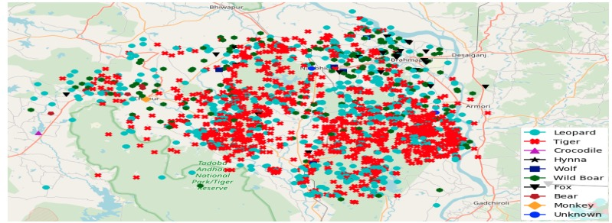
1. Introduction (contd.)
To ensure seamless deployment, scalability, and real-time updates, the project will incorporate DevOps practices, including CI/CD pipelines, containerization with Docker and Kubernetes, and monitoring tools for system reliability. A cloud-based dashboard and alert system will provide visual insights and notifications to park authorities, conservationists, and local communities, enabling early intervention strategies such as warning systems, controlled movements, and preventive measures.
By leveraging cloud computing, DevOps methodologies, and advanced AI-driven algorithm design, this project will transform the management of human-animal conflicts, reducing casualties, preserving wildlife, and fostering harmony between human populations and nature.
Figure 1: GPS plot of human-animal conflicts in the Bramhapuri Forest Division, India from 2014 to 2017

Slide 5
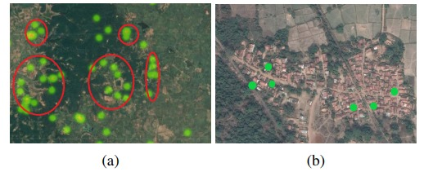
2. Problem Statement
This project aims to develop a cloud-based predictive system using IoT sensors, GPS tracking, satellite imagery, and machine learning to identify high-risk zones. DevOps integration will ensure scalability, real-time updates, and automated alerts. The goal is to reduce conflicts, enhance early warning systems, and protect both humans and wildlife through data-driven decision-making.
Figure 2: Green dots highlight individual conflicts.
(a) Clustered conflicts (highlighted in red) appear near the intersection of terrains. The darker green areas denote dense forested areas, while the lighter areas have sparse vegetation.
(b) Conflicts at the boundary of human settlements and forests.

Slide 6
3. Motivation
The project aims to have the following features:-
Human-animal conflict (HAC) in India is escalating due to deforestation, urbanization, and habitat fragmentation, leading to crop damage, livestock loss, and fatalities. These conflicts threaten both human lives and endangered species, often resulting in retaliatory killings and habitat destruction.
This project aims to develop a technology-driven approach using cloud computing, IoT, satellite imagery, and machine learning to predict high-risk areas and enable proactive conflict mitigation. AI-driven analytics will help authorities issue alerts, deploy response teams, and implement preventive measures like fencing and controlled grazing.
By integrating conservation efforts with real-time, cloud-based data, the system will enhance decision-making and adaptability. Reducing conflicts will protect both humans and wildlife, fostering coexistence and sustainable conservation while serving as a model for global biodiversity protection.

Slide 7
4. Objective
To Develop a cloud-based, AI-driven predictive system to identify high-risk human-animal conflict zones and provide real-time alerts for mitigation.
Sub-Objectives:
1. Real-Time Data Collection: Deploy IoT sensors, GPS collars, and satellite imagery
to track animal movements and environmental changes affecting conflict probability.
2. Predictive Analytics Using Machine Learning: Use classification, clustering, and
reinforcement learning algorithms to detect patterns and forecast high-risk human
animal conflict areas.
3. Cloud-Based Data Processing & Storage: Utilize AWS/Azure for scalable storage
and processing, ensuring secure, real-time access to conflict prediction data.
4. DevOps Integration for Scalability & Reliability: Implement CI/CD pipelines,
containerization, and monitoring tools to ensure system scalability, reliability, and
continuous updates.
5. Community & Government Collaboration: Provide data-driven insights to forest
officials, NGOs, and policymakers for improved conservation strategies and conflict
mitigation.

Slide 8
5. Methodology
1. Data Collection
• Deploy IoT-enabled sensors, camera traps, and GPS collars to monitor animal movements.
2. Data Processing & Cloud Infrastructure
• Store and process data using AWS/Azure cloud services for scalability and security.
• Implement serverless computing (AWS Lambda, Azure Functions) for real-time event
driven processing.
3. Predictive Analytics & Machine Learning
• Apply classification models to identify high-risk zones.
• Use clustering techniques (K-Means) to detect conflict hotspots.
4. Visualization & Alert System
• Develop cloud-based dashboards (Power BI , Grafana) for real-time data visualization.
5. DevOps & System Automation
• set up CI/CD pipelines (Jenkins, GitHub Actions) for continuous model updates and system
improvements.
• Use Docker and Kubernetes for scalable and efficient model deployment.

Slide 9
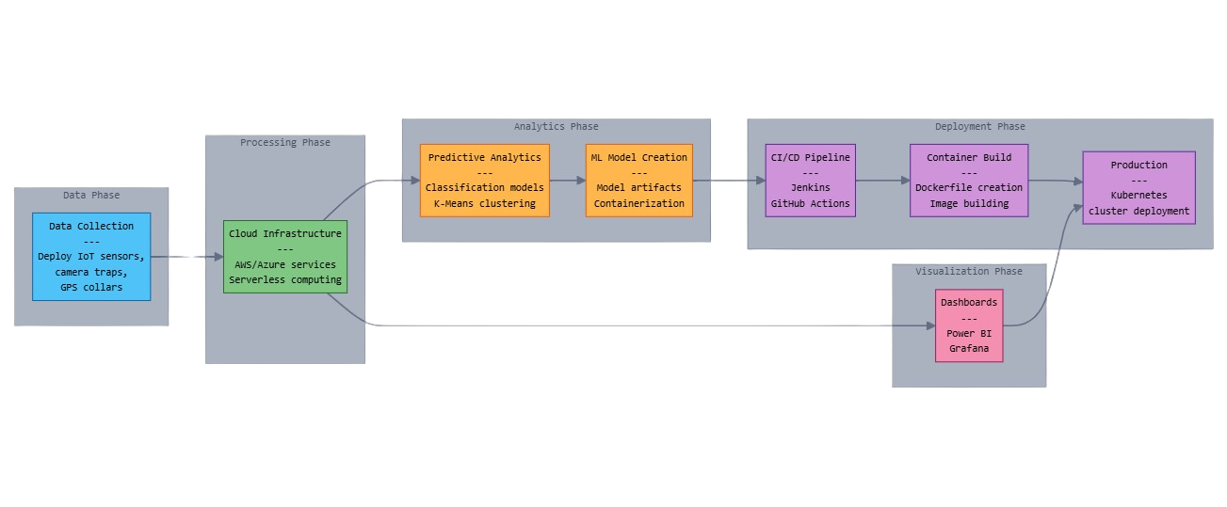
5. Methodology (contd.)
Fig.3 Methodology Chart

Slide 10


6. Technology Stack
1. Cloud Computing & Storage
Cloud platforms store and process real-time and historical data on animal movements and conflicts, enabling quick decision-making and collaboration among conservationists and authorities.
2. IoT & Data Collection
IoT devices like GPS collars, sensors, and camera traps track wildlife movements and human interactions, transmitting real-time data for early detection and timely conflict prevention.
3. Machine Learning & AI
AI analyzes data to predict high-risk zones, generating early warnings based on patterns in animal behavior, weather, and past conflicts, enabling proactive mitigation measures.
4. DevOps & Automation
DevOps automated data processing, model updates, and system monitoring, ensuring continuous accuracy, real-time alerts, and efficient resource deployment for conflict prevention.

Slide 11
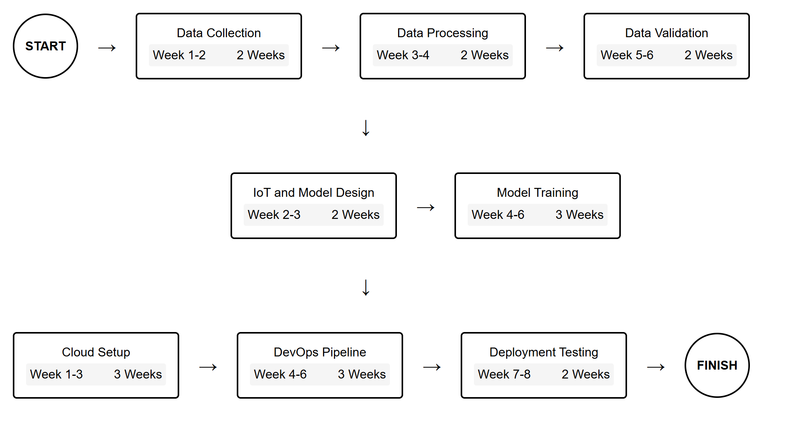
7. PERT Chart
Fig.4 Program Evaluation Review Technique Chart

Slide 12
8. References
1. Joshi, A., & Singh, P. (2018). GIS-based predictive modeling for human-animal conflict zones. Wildlife Conservation Journal, 12(3), 45-59.
2. Kumar, R., Patel, S., & Sharma, D. (2021). Integrating satellite imagery and tracking data for conflict prediction. Environmental Monitoring and Assessment, 189(4), 102-118.
3. Sharma, V., & Rao, M. (2022). Deep learning applications in wildlife movement and human encroachment analysis. International Journal of AI in Conservation, 9(1), 23-38.
4. Patel, N., Verma, S., & Rao, K. (2019). Cloud computing for real-time wildlife monitoring: A case study. Cloud and IoT Journal, 7(2), 54-69.
5. Gupta, P., Mehta, R., & Roy, L. (2020). Machine learning approaches for predicting wildlife movement and conflict risk. AI in Ecology Research, 6(4), 78-94.
6. Desai, H., Banerjee, A., & Choudhury, T. (2023). CNN-based wildlife species identification for conflict mitigation. Journal of Applied Machine Learning, 15(3), 112 130.
7. Nair, K., & Sharma, V. (2019). DevOps for efficient AI model deployment in conservation efforts. Computational Sustainability Review, 5(1), 29-45.
8. Banerjee, S., & Choudhury, P. (2021). Scalable wildlife data processing using containerization and cloud platforms. Journal of Cloud Computing in Ecology, 8(2), 37 52.

Slide 13
Thank You

